Slide 1
EEEE2076 – Software Development Project
Computer Graphics, VR and AR

Slide 2
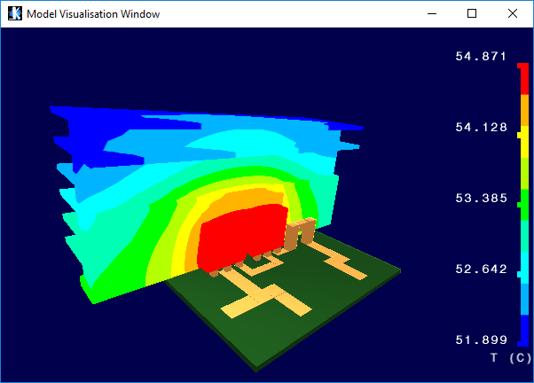
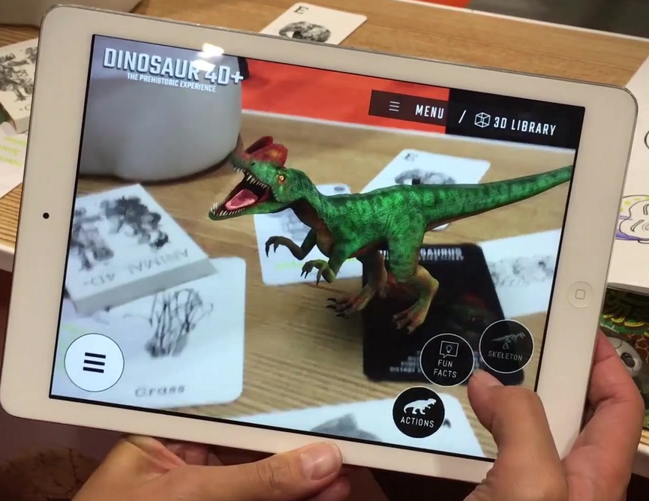
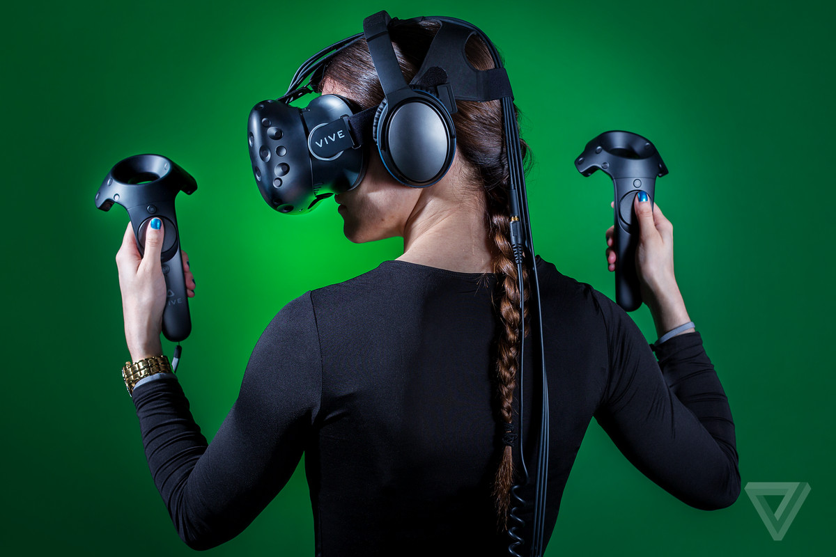
Aims of this session
Understand how 3D objects are rendered on a computer
Develop basic knowledge of “low level” graphics libraries such as OpenGL and the graphics pipeline
Understand how Virtual and Augmented Reality applications differ from “traditional” graphics
Notes:
We will not use OpenGL directly in this project, we will use a “high level” library that acts as an interface to OpenGL.
Too difficult/time-consuming to write useful software using OpenGL directly in this project.
I can offer projects in this area for final year projects if you are interested

Slide 3

Computer Graphics: Overall Aim
Generally applicable processes and hardware
Can be programmed to render / display anything – CAD models, games, etc
Realistic Images
High resolution (lots of pixels per unit area)
Simulated physical effects (fire, smoke, …)
Lighting effects (shadows, reflections, translucency, …)
Computational Efficiency / Speed
Usually need to recalculate/redraw images many times per second
Generally > 25fps for smooth images
Achieved using relatively standardised techniques
Methods for describing 3D geometry: vertices, polygons, textures
Methods for computing lighting
Standard set of process to get from geometry to final image – the graphics pipeline
Libraries that make the pipeline hardware independent (same game runs on various graphics cards) – e.g. OpenGL and DirectX

Slide 4
Graphics Data Format
V1
V2
3D models described as polygons
Primitive 2D shapes in 3D space
Usually triangles – because they always define flat surface
All graphics code ends up sending arrays of data to the graphics card
Vertex Array (floating point)
Coordinates of corners (vertices)
x, y, z triplets
V3
V4
V5
VA | V1 |  |  | V2 |  |  | V3 |  |  | V4 |  |  | V5
 | x1 | y1 | z1 | x2 | y2 | z2 | x3 | y3 | z3 | x4 | y4 | z4 | x5 | y5 | z5
double verts[] = { 0.,0.,0., 0.,1.,2., 1.,1.,1., 2.,3.,1., 3.,1.,1. }

Slide 5
Graphics Data Format
V1
V2
3D models described as polygons
Primitive 2D shapes in 3D space
Usually triangles
All graphics code ends up sending arrays of data to the graphics card
Polygon Array (integers)
How are polygons created in terms of vertices
Sequence is important
Either Clockwise (CW) Counter-Clockwise Winding (CCW) – this is order as viewed from front of polygon
Front/back matters as it affects rendering:
Don’t draw surfaces facing away from camera (back face culling) – polygon is invisible from rear
Surface direction (called surface normal vector) used in lighting calculations
V3
V4
V5
PA | P1 |  |  | P2 |  |  | P3
 | 1 | 3 | 2 | 3 | 4 | 2 | 3 | 5 | 4
int polys[] = { 1,3,2, 3,4,2, 3,5,4 }

Slide 6

Graphics Data Format
V1
V2
Also need specify the colour of the polygons
Actually specify colour at vertices
Usually specify colour in terms of a texture
Array of pixels (1D or 2D)
A coordinate (0-1) used to specify location in this array
If you know temperature of a 3D object at its vertices:
1 = hot
0 = cold
Scale temperature at vertices to normalised texture coordinate (u)
Graphics card will create nice colourful temperature plot
Texture must also be uploaded to graphics card
V3
V4
V5
1
0
1
u
0
0
v
1
u
2D Textures & texture coordinates (u,v) can also be used to map patterns onto polygons
double tcs[] = { 0.9, 0.75, 0.8, 0.2, 0.1 }

Slide 7
Graphics Data Format
V1
The texture is an array that describes the colour of each pixel in the colourmap.
A 1D colourmap is a 1D array of pixels (lets say 256 pixels), each pixel will have RGBA colour components:
R – red
G – Green
B – Blue
A – Alpha channel (inverse of transparency)
1. = solid colour
0. = completely transparent
V2
Also need specify the colour of the polygons
Actually specify colour at vertices
Usually specify colour in terms of a texture
Array of pixels (1D or 2D)
A coordinate (0-1) used to specify location in this array
If you know temperature of a 3D object at its vertices:
1 = hot
0 = cold
Scale temperature at vertices to normalised texture coordinate (u)
Graphics card will create nice colourful temperature plot
Texture must also be uploaded to graphics card
V3
V4
V5
1
0
1
u
0
0
v
1
u
2D Textures & texture coordinates (u,v) can also be used to map patterns onto polygons
double tcs[] = { 0.9, 0.75, 0.8, 0.2, 0.1 }

Slide 8
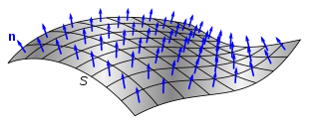
Graphics Data Format
V1
V2
Each vertex will usually have a normal vector
Vector that is normal to the surface passing through the vertex
Used to calculate light reflections, etc on the surface
Normal means at right angle to surface
Doesn’t have to be though – modifying the normals so they vary (not quite 90°) imitates reflections from a surface that isn’t perfectly flat: one that is rough or textured. This is called bump mapping – making a surface appear textured by modifying the lighting calculation only.
Usually a unit normal, i.e. scaled so the magnitude of normal vector is one
V3
V4
V5
double normals[] = { 1.,0.,0., 0.71,0.71,0.71, 0.,0.,1., 0.,0.,1., 0.57,0.57,0.57 }
Generic normal image taken from Wikipedia which illustrates normal vectors on a surface.
Logic says each polygon would have its own normal vector. This is NOT how OpenGL works, the normal vectors are defined at each vertex.

Slide 9
Graphics Data Format - Summary
Define objects in a virtual world as:
Array of vertices (corners)
Array of polygons that link the corners together
Array of Texture Coordinates (point in a colour map or texture for each vertex)
Array of vertex normals (defines surface orientation at each vertex)
These are uploaded to graphics card as vertex array object (VAO)
Each array is called a vertex buffer
Can upload multiple VAOs
E.g. one set for all objects in one area of model, one for those in another area
Graphics card can be asked to render each VAO independently and with a different shader
A colourmap or texture must also be uploaded
double verts[] = { 0.,0.,0., 0.,1.,2., 1.,1.,1., 2.,3.,1., 3.,1.,1. };
double normals[] = { 1.,0.,0., 0.71,0.71,0.71, 0.,0.,1., 0.,0.,1., 0.57,0.57,0.57 };
double tcs[] = { 0.9, 0.75, 0.8, 0.2, 0.1 };
int polys[] = { 1,3,2, 3,4,2, 3,5,4 };

Slide 10
Typical OpenGL code for creating and filling VAOs
We are not going to use OpenGL directly, but it can help if you know approximately what is going on in the background
Create
Fill
/* Vertex Array Object for solid objects */ glGenVertexArrays( 1, &md->objectVertexArray ); /* Enable this VAO */ glBindVertexArray( md->objectVertexArray ); glGenBuffers( 1, &md->objectIndexBuffer ); // polygon index glGenBuffers( 1, &md->objectVertexBuffer ); // vertex coords glGenBuffers( 1, &md->objectTextureBuffer ); // vertex tex coords glGenBuffers( 1, &md->objectNormalBuffer ); // vertex normals
// Polygon index array glBindBuffer( GL_ELEMENT_ARRAY_BUFFER, md->objectIndexBuffer );
// vertex coordinates glEnableVertexAttribArray( 0 ); glBindBuffer( GL_ARRAY_BUFFER, md->objectVertexBuffer ); glVertexAttribPointer( 0, 3, GL_FLOAT, GL_FALSE, 0, (void*)0 );
// vertex colours glEnableVertexAttribArray( 1 ); glBindBuffer( GL_ARRAY_BUFFER, md->objectTextureBuffer ); glVertexAttribPointer( 1, 1, GL_FLOAT, GL_FALSE, 0, (void*)0 );
// Normals glEnableVertexAttribArray( 2 ); glBindBuffer( GL_ARRAY_BUFFER, md->objectNormalBuffer ); glVertexAttribPointer( 2, 3, GL_FLOAT, GL_FALSE, 0, (void*)0 );
/* Enable VAO for solid objects */
glBindVertexArray( md->objectVertexArray );
/* Upload vertex coords */
glBindBuffer(GL_ELEMENT_ARRAY_BUFFER, md->objectIndexBuffer ); glBufferData(GL_ELEMENT_ARRAY_BUFFER, nObjIndex*sizeof(GLuint), objIndex,
GL_STATIC_DRAW );
/* Upload vertex coords */
glBindBuffer( GL_ARRAY_BUFFER, md->objectVertexBuffer ); glBufferData( GL_ARRAY_BUFFER, nObjVert*sizeof(GLfloat), objVerts, GL_STATIC_DRAW );
/* Upload vertex coords */
glBindBuffer( GL_ARRAY_BUFFER, md->objectTextureBuffer ); glBufferData( GL_ARRAY_BUFFER, nObjVert*sizeof(GLfloat), objColour, GL_STATIC_DRAW );
/* Upload vertex coords */
glBindBuffer( GL_ARRAY_BUFFER, md->objectNormalBuffer ); glBufferData( GL_ARRAY_BUFFER, nObjVert*sizeof(GLfloat), objNormals, GL_STATIC_DRAW );
Draw
/* Enable VAO for solid objects */
glBindVertexArray( md->objectVertexArray );
/* Draw polygons, assuming array describes triangular polygon */ glDrawElements( GL_TRIANGLES, md->nSolidObject, GL_UNSIGNED_INT, (void *) 0);

Slide 11
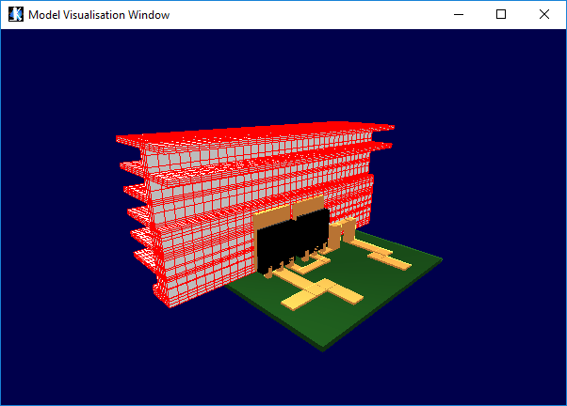
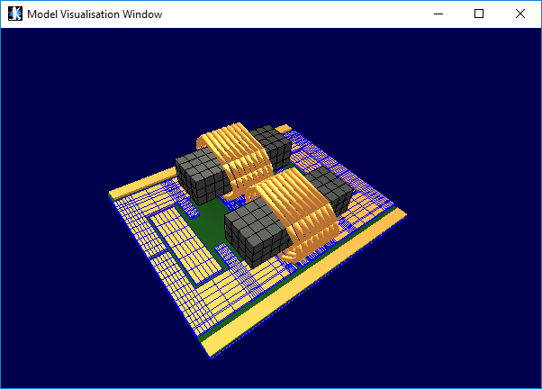
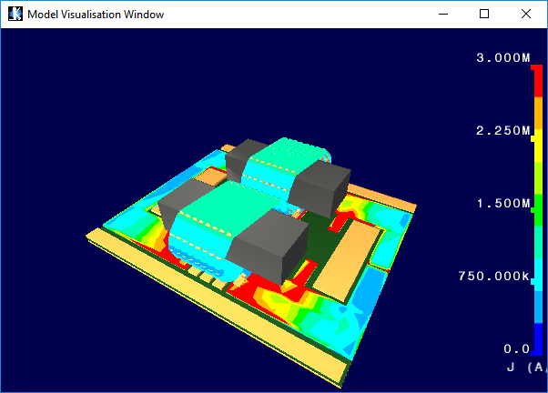
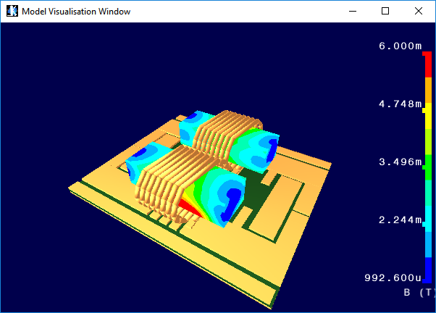
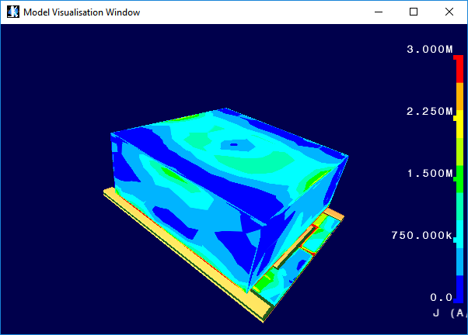

Slide 12
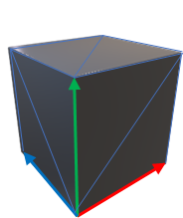
Creating an Interactive Rendering
Imagine a cube represented as a set of polygons, rendered in 3D
You might want to change the size or properties of this cube.
Object will be positioned in a virtual “world”
You might want to change the position of objects in the world
User will view the world from a defined viewpoint – the “camera location”
You might want to change the camera location – walk around the world, rotate the camera, etc
A 2D rendering of the object, positioned in the world, as viewed from the camera location is drawn on the computer screen
Camera properties affect this, e.g. zoom and wide-angle lens give different images of same world at same location

Slide 13
Coordinate Systems or “spaces”
Graphics libraries describe objects in coordinate systems
Coordinate system has an origin (0,0,0) and also an orientation (i.e. the x-axis points in a certain direction)
One location (vertex) can have different coordinates depending on which coordinate system is used:
Relative to an origin – move origin, change coordinates
Also depends on coordinate system orientation.
Multiple coordinate systems can be used to describe the same objects
Translations and rotations can be used to map between coordinate systems
A point described in CS1 (e.g. 30,3,3) can be expressed in CS2 through a translation (e.g. it might be 3,3,3)
A point described in CS3 (e.g. 3,3,3) can be expressed in CS4 through a rotation (e.g. it might be 1,-2,3)
CS1
CS2
y
y
z
z
x
x
y
CS4
y
CS3
x
z
x
z

Slide 14
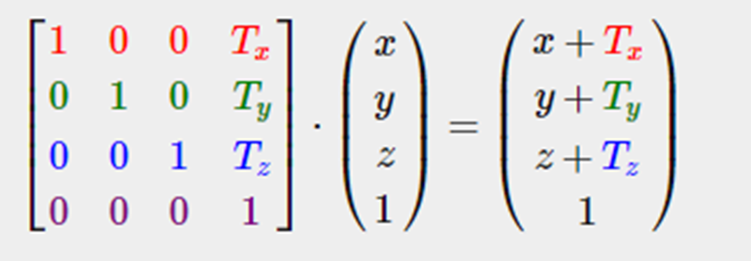

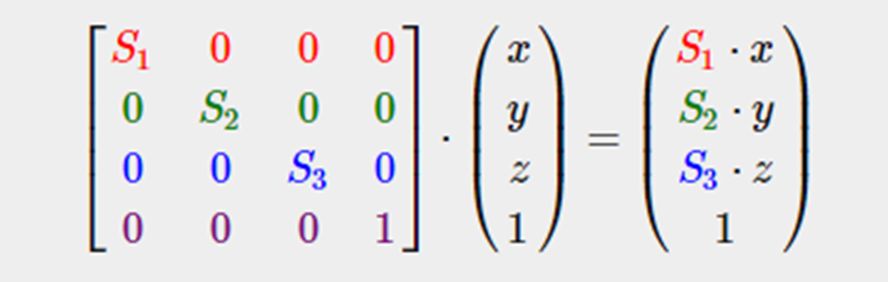

Transform Matrices
You can get from one coordinate system to another through a combination of:
Translations (adding/subtracting from a vector)
Rotations (rotate vector about an axis)
Scaling
All of the above can be achieved by multiplying a vector by a matrix.
Vectors with length 4 and 4x matrices are used for graphics
[x,y,z, w]
The w component is usually 1 or zero, 1 indicates the vector is describes a position in space, 0 indicates that it describes a direction
Position vectors are affected by translations
Direction vectors are not affected by translations
Multiple rotations, translations and scaling operations can be combined into a single transform matrix that allows mapping between two coordinate systems
Translation of a position vector
Rotation about x-axis
Scaling
https://learnopengl.com/Getting-started/Transformations
Or
OpenGL Red Book

Slide 15
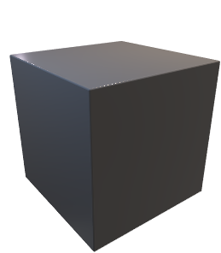
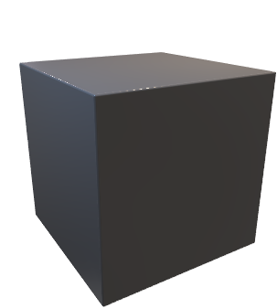
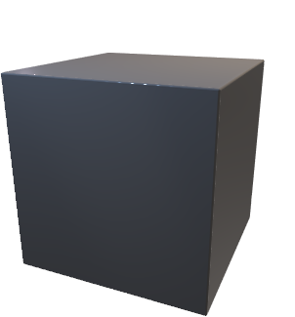
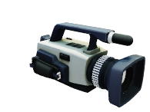
Coordinate Systems or “spaces”
Usually there are three types of 3D coordinate system
Object space – each object has a coordinate system
If an object is loaded from a CAD file, it will be described in the file in its own coordinate system
The origin might be at the centre of the object or in one corner
World space – a global coordinate system for the virtual world
If you place 2 objects in a world, they each have their own coordinate system, but the world has a global coordinate system
An object’s coordinates in world space depend on where the object is positioned and how it is rotated
If you move an object in the world, its world coordinates change to reflect its new position
Camera space – a global coordinate system aligned with the “camera” or users viewpoint
Camera space always has its origin immediately in front of the user’s viewpoint.
The x axis aligns with left-right of the users view, and y-axis down-up.
The z-axis is chosen so that it points in the direction of the users view
If the user moves around the world (e.g. walking in a first person game), the camera position moves to reflect the new viewpoint
The camera space origin is updated accordingly
Although all objects are now in the same position in world space, their position in camera space has changed – because their position relative to the camera has changed.

Slide 16
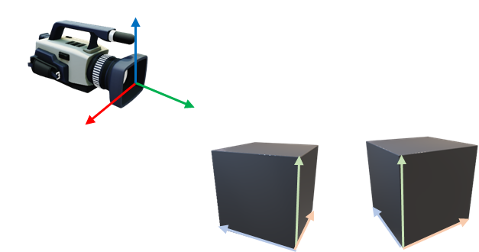
Camera Space – Why?
Why is camera space special?
It is a critical link in being able to generate the 2D view on the screen
In camera space, the z coordinate of an object now represent the distance from the screen
The x and y coordinates of an object represent its position on the screen
Not quite that simple, but close
Camera space allows the 3D model to be converted to a 2D drawing on the screen
y
z
x

Slide 17
Projection space – the 2D view
You can’t just take the camera space coordinates, ignore z and use x,y as screen coordinates
This does account for perspective – things further away appear smaller than things that are close
Process is:
Order objects according to their z coordinate
Ignore things that have a negative z-coordinate (behind screen)
Apply a projection transformation – this scales objects according to their distance from the screen
Can be used to introduce related effects, e.g. field of view, equivalent to the distortion a “fish-eye” camera lens will create
Draw objects in reverse order of distance, this draws objects that are closer over the top of things that are further away
Results in a 2D drawing, coordinates still have a global scaling
Also called Clip Space as items that won’t be drawn are clipped
Some variations on Projection Space coordinates
NDC space
Normalised Device Coordinates
2D coordinates are scaled to the range (-1,1) – allows mapping to screen/window of difference sizes
Screen Space or Raster Space
Final transform – map the NDC coordinates to pixel coordinates
Depends on screen/window size
y
z
x
In screen coordinates, origin is generally at top left of screen
X direction is left to right
Y direction is top to bottom

Slide 18
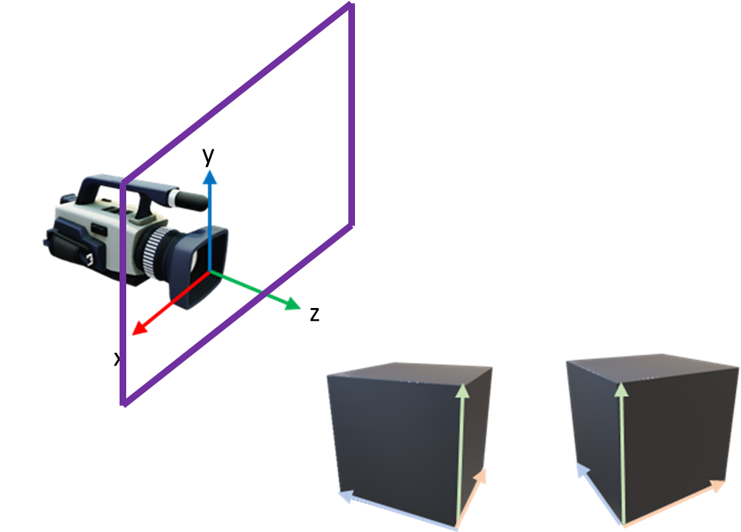

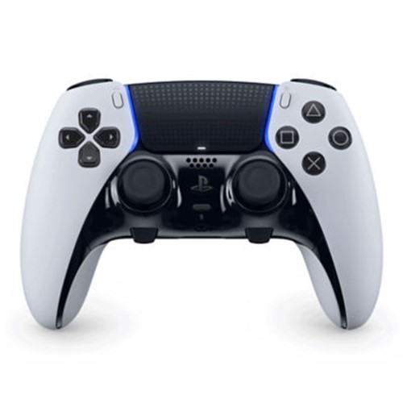
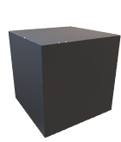
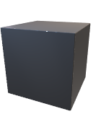
The Pipeline
Each object will have own transforms
Objects placed in virtual world (scene created)
World rotated to align with camera
3D->2D Projection
Individual objects / models
Relatively slow update rate for most objects – once position in world defined, might not need to move that frequently
Ideally > 25 Hz (Frames per second)

Slide 19

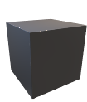
This part (manipulating objects in world) generally handled by main processor.
Per frame update handled by graphics card. Data arrays only need to be updated relatively infrequently, Transform matrix will be updated at each frame as user view point changes
Each object will have own transforms
Objects placed in virtual world (scene created)
World rotated to align with camera
3D->2D Projection
Individual objects / models
Relatively slow update rate for most objects – once position in world defined, might not need to move that frequently
Ideally > 25 Hz (Frames per second)

Slide 20
Graphics Card Implementation - Shaders
Vertex shader – apply matrix transforms
#version 330 core // Input vertex data, different for all executions of this shader. layout(location = 0) in vec3 vertexPosition_modelspace; layout(location = 1) in vec3 vertexTc; layout(location = 2) in vec3 vertexNormal_modelspace; // Output data ; will be interpolated for each fragment. out vec4 tc; out vec3 fragPos; out vec3 vertexNormal; out vec3 lightPos; // Values that stay constant for the whole mesh. uniform mat4 P; uniform mat4 V; uniform mat4 M; uniform float alpha; void main(){ // Output position of the vertex, in clip space : MVP * position gl_Position = P*V*M* vec4( vertexPosition_modelspace, 1 ); lightPos = vec3( vec4(100.,100.,100., 1) ); fragPos = vec3( M*vec4( vertexPosition_modelspace, 1 ) ); vertexNormal = vertexNormal_modelspace; // The texture coordinate for each vertex will be interpolated // to produce the color of each fragment – texture lookup in fragment shader tc = vertexTc }
The transforms performed by graphics card must be applied to many polygons simultaneously
Two types of calculation
Vertex calculations (world transforms)
Fragment calculations (texture mapping and application of lighting effects)
Two programs run on graphics card:
Vertex shader
Fragment shader
For modern versions of OpenGL (>1.3) you are required to write these
Written in GL Shader Language (GLSL)
Programs are relatively simple, but are applied to thousands / millions of vertex/pixel calculations simultaneously
Graphics processors have lots of cores – 1920 in the case of the ones we have in labs
Can also be repurposed for scientific computing – see 4th year Advanced Computing module
Sometimes graphics cards can also be used for non-graphics calculations in games – “Compute Shaders”

Slide 21
#version 330 core // Input vertex data, different for all executions of this shader. layout(location = 0) in vec3 vertexPosition_modelspace; layout(location = 1) in vec3 vertexTc; layout(location = 2) in vec3 vertexNormal_modelspace; // Output data ; will be interpolated for each fragment. out float tc; out vec3 fragPos; out vec3 vertexNormal; out vec3 lightPos; // Values that stay constant for the whole mesh. uniform mat4 P; uniform mat4 V; uniform mat4 M; void main(){ // Output position of the vertex, in clip space : MVP * position gl_Position = P*V*M* vec4( vertexPosition_modelspace, 1 ); lightPos = vec3( vec4(100.,100.,100., 1) ); fragPos = vec3( M*vec4( vertexPosition_modelspace, 1 ) ); vertexNormal = vertexNormal_modelspace; // The texture coordinate for each vertex will be interpolated // to produce the color of each fragment – texture lookup in fragment shader tc = vertexTc }
#version 330 core // Interpolated values from the vertex shaders in float tc; in vec3 fragPos; in vec3 vertexNormal; in vec3 lightPos; // Output data out vec4 colour;
uniform sampler1D textureSampler; // Texture to use uniform float alpha; // Override alpha channel void main(){ vec3 lightDir; float diff; vec3 diffuse; vec3 eye = normalize(-fragPos); vec3 spec; vec3 ambColour = vec3(1.0,1.0,1.0); vec3 diffColour = vec3(1.0,1.0,0.9); vec3 specColour = vec3(1.0,1.0,0.9); vec3 norm = normalize(vertexNormal); lightDir = normalize(lightPos - fragPos); diff = max(dot(norm, lightDir), 0.0); if( diff > 0. ) { diffuse = diffColour*diff; vec3 h = normalize( lightDir + eye ); float intspec = max( dot(h,norm), 0.0 ); spec = specColour*pow(intspec, 2); } vec3 ambient = ambColour;
colour = vec4( texture( textureSampler, tc ).rgb, alpha ); colour = vec4( (ambient + diffuse + spec), 1 ) * colour; }
Vertex shader
Fragment shader

Slide 22
Lighting

Slide 23
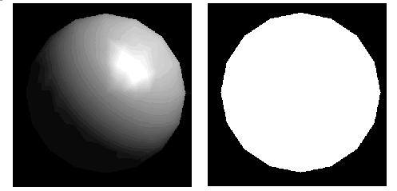
Lighting
3D renderings don’t appear to be 3D without an attempt to approximate lighting effects
Aim:
Modifying colours in a 3D model to add depth, makes model look more realistic
If everything that is white, is the same shade of white, model looks “flat”
In reality, 10 identical white surfaces, will all appear as slightly different colours.
Colour/brightness of light falling on them
Position of light sources
Angle of surfaces, relative to position of light sources and observer
A white sphere, with and without lighting effects.
With lighting effects, each part of surface is different shade of white/grey according to orientation.
Without lighting effects, all areas are the same colour and the 3D effect is lost.

Slide 24
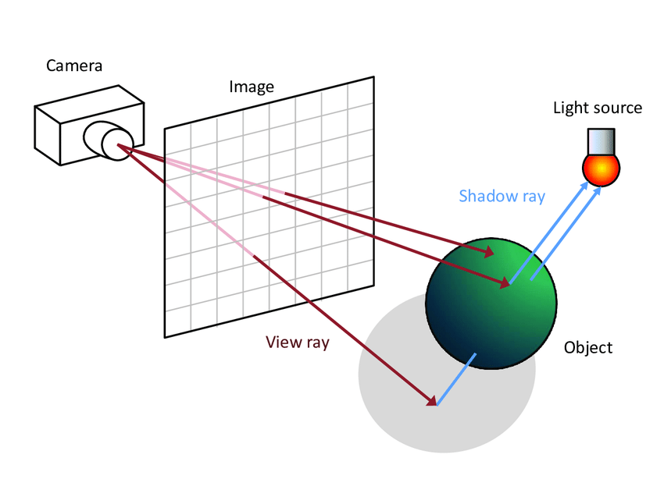
Lighting
In reality:
Light travels from light source, as its own colour
Hits a surface and some reflects off
Colour of surface affects colour of reflected light
Orientation of surface affects general direction light is reflected
Surface properties how light is reflected (smooth, matte, etc)
Light may travel to another surface an reflect off that
E.g. surface 1 is sphere, surface two is polished stainless steel
Light reflected no is combination of light source properties, first object properties, second object properties
Light eventually reaches your eye
In this example, you see sphere reflected in polished surface
Lighting can be modelled in this way on computers – called raytracing
Lines (rays) are usually traced from viewers eye point through each pixel on screen and reflected off surfaces in model until light sources reached
Reverse direction is more efficient as rays coming from light source that never reach user’s eye are not calculated.
Each reflection of ray affects final colour of pixel
Raytracing:
Very computationally demanding, until relatively recently wasn’t used in real-time (games, VR, etc). Used in high quality image and video production (e.g. in the later Pixar animated films)
Is now possible, graphics cards incorporate hardware features e.g. NVIDIA RTX series. Not necessarily “full quality” ray-tracing though.
Raytracing: Approximating real lighting, but tracing view rays backwards
(Source: PhD Thesis: Dubla, Piotr. (2011). Interactive Global Illumination on the CPU. )

Slide 25
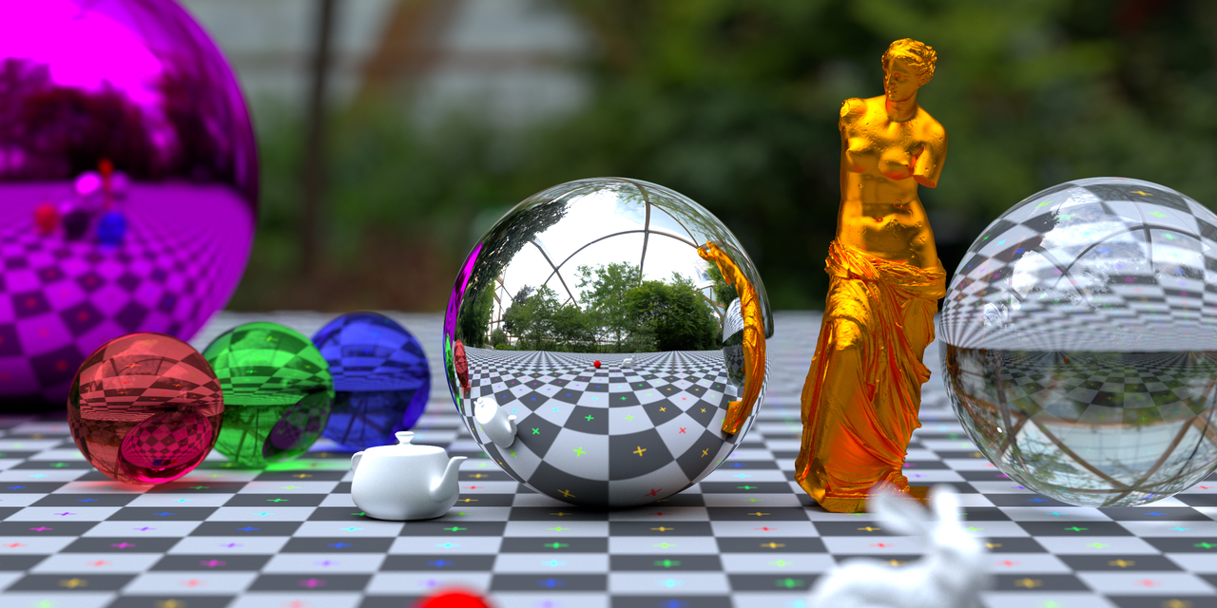
Image generated using “Offline” Raytracing image generation library, c-ray. https://github.com/vkoskiv/c-ray
8 minutes for 1 image!

Slide 26
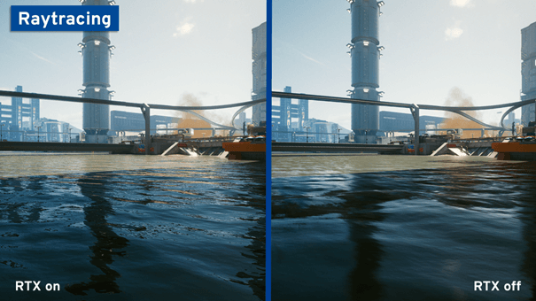
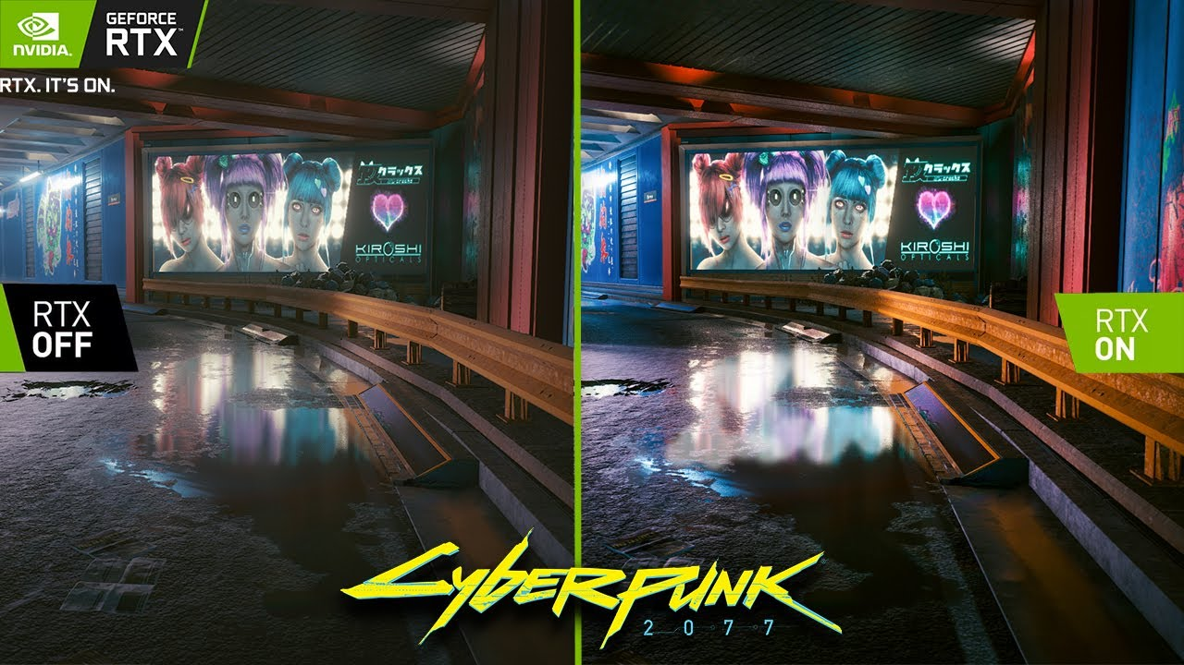
Some images from game reviews where raytracing is enabled/disabled (online ray-tracing)
I just pulled these from a Google images search.
No where near the image quality of previous image, to be expected – image regenerated 25+ times per second.
The summary from one of the reviews was “ray-tracing is a waste of time (in real-time applications)”!
Just one person’s opinion, but indicates that current hardware can’t do a proper job fast enough to see full benefit of ray-tracing methods.
Obviously hardware will improve and this will probably change!

Slide 27
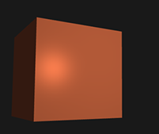
Lighting
So: If raytracing is not possible (or only partially possible), how do computers approximate lighting effects?
“Phong” lighting model or Phong Shading
Basis of many simple lighting models
3 approximate lighting effects
Ambient:
Light all surfaces equally
Diffuse:
Light surfaces according to orientation relative to light source
Surfaces that face light are brighter
Surfaces facing away from light are darker
Reflected light colour is combination of light colour and surface colour
Specular:
Light surfaces according to orientation relative to light source and user viewpoint
Allows reflections to be approximated
You can see reflection of light bulb location in a shiny surface if angles allow
Source: OpenGL Red Book for details, image from https://learnopengl.com/Lighting/Basic-Lighting

Slide 28
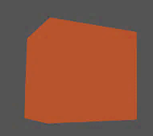
Lighting - Ambient
Light all surfaces equally
Light sources do not have a position (or their position has no effect on final result)
Gives basic background lighting
Adds balance to other effects
Compensates for fact that with diffuse lighting, diffuse light sources will not reflect off other surfaces as in reality
With only ambient lighting, image is flat
Can’t see edge between two cube faces in this example
Model doesn’t have a true 3D look
Can be confusing to user, sometimes difficult to see orientation of objects
Full Phong Lighting
Note: brightness of image modifed to make display better on projector, hence grey background
Ambient Only
Source: OpenGL Red Book for details, image from https://learnopengl.com/Lighting/Basic-Lighting

Slide 29
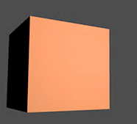


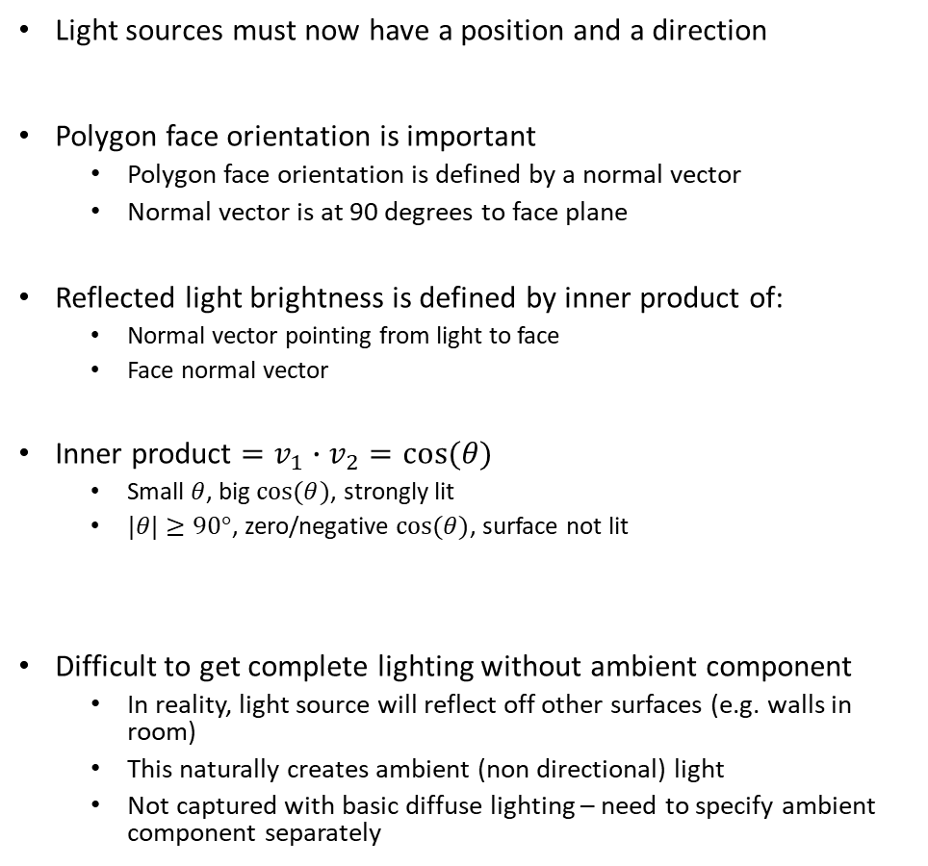

Lighting - Diffuse
$$θ$$
Light sources must now have a position and a direction
Polygon face orientation is important
Polygon face orientation is defined by a normal vector
Normal vector is at 90 degrees to face plane
Reflected light brightness is defined by inner product of:
Normal vector pointing from light to face
Face normal vector
Inner product $=v_{1}∙v_{2}=cos⁡(θ)$
Small $θ$, big $cos⁡(θ)$, strongly lit
$|θ|≥90°$, zero/negative $cos⁡(θ)$, surface not lit
Difficult to get complete lighting without ambient component
In reality, light source will reflect off other surfaces (e.g. walls in room)
This naturally creates ambient (non directional) light
Not captured with basic diffuse lighting – need to specify ambient component separately
$$θ$$
Normal means $\left|v\right|=1$
Diffuse Only – unlit back surface
Source: OpenGL Red Book for details, image from https://learnopengl.com/Lighting/Basic-Lighting
Full Phong Lighting

Slide 30
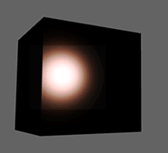

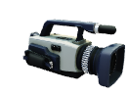
Lighting - Specular
Light sources must have a position and a direction
Polygon face orientation is important
Polygon face orientation is defined by a normal vector
Normal vector is at 90 degrees to face plane
User viewpoint is important
Draw vectors between source and surface, and viewpoint and surface
Lighting on a surface is brightest where you see reflection of source in surface
Look at a light bulb via a mirror, the mirror surface is bright in the location where you see the lightbulb
This depends on relative orientation of you, lightbulb, mirror, and mirror surface angle
Change mirror angle and bright spot moves, might even disappear.
Extent of reflection also depends on “shininess” of surface
Reflected light brightness is defined by inner product of vector defining natural reflection angle, and vector from surface to viewpoint, taking into account shininess of surface
Specular lighting can bring lighting to life, can also look ridiculous if it dominates
$$θ$$
Natural reflection angle of source from surface
Viewpoint location
Reflection brightest here
Specular Only – Adds highlight
Source: OpenGL Red Book for details, image from https://learnopengl.com/Lighting/Basic-Lighting
Full Phong Lighting

Slide 31
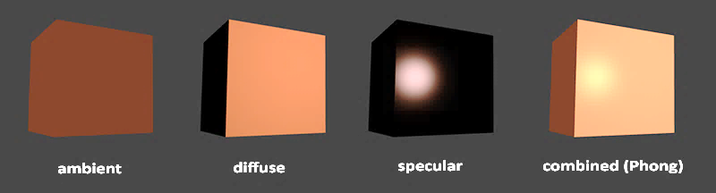
Lighting
Source: OpenGL Red Book for details, image from https://learnopengl.com/Lighting/Basic-Lighting
Full Phong Lighting

Slide 32
Augmented Reality

Slide 33
What is it?
Augmented reality: computer generated effects overlaid onto live video streams
Artificial effects are oriented and scaled so that they appear to be part of real word
Can be deployed on mobile devices or using mixed reality glasses
Technical requirement:
World transform matrix must be able to align virtual and real world
References in real world used to compute appropriate transform
Projection matrix must match camera properties (e.g. lens field of view)

Slide 34

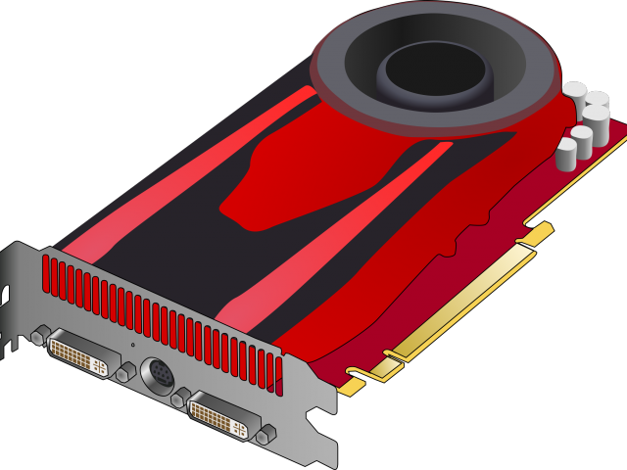


Implementation
Video feed
AR Code
Library
Trained to recognise marker patterns in video feed
Marker defines origin and orientation of “model” coordinate system in “real world”
Library determines required rotations and translation to align model and real-world
Produces transform and projection matrices
AR libraries include AR Toolkit – Open Source library
World Transform Matrix
Model rendered as overlay on video feed
Main challenge is tracking rotation of camera relative to real world and constantly updating transform matrix
y
Projection Matrix
z
x

Slide 35
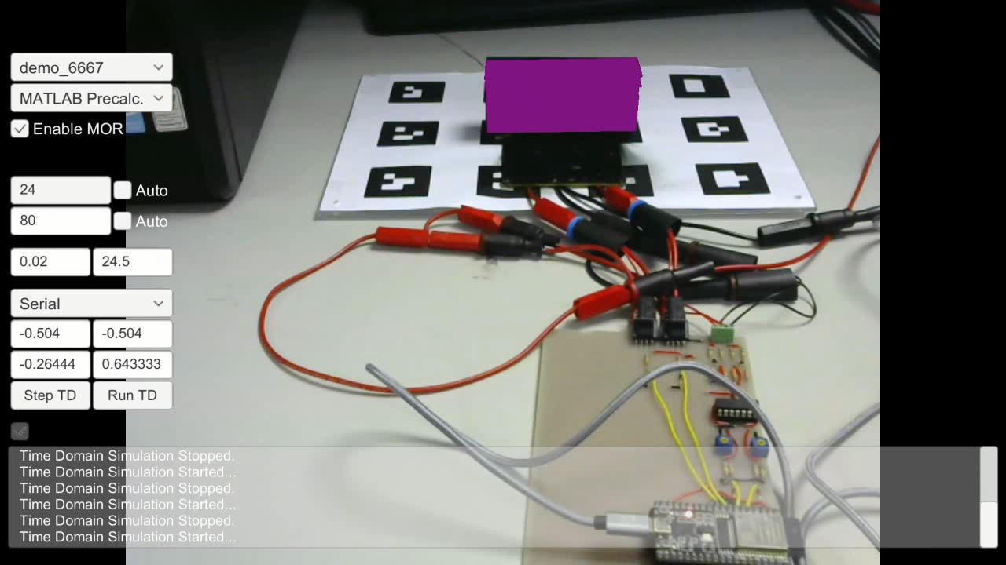
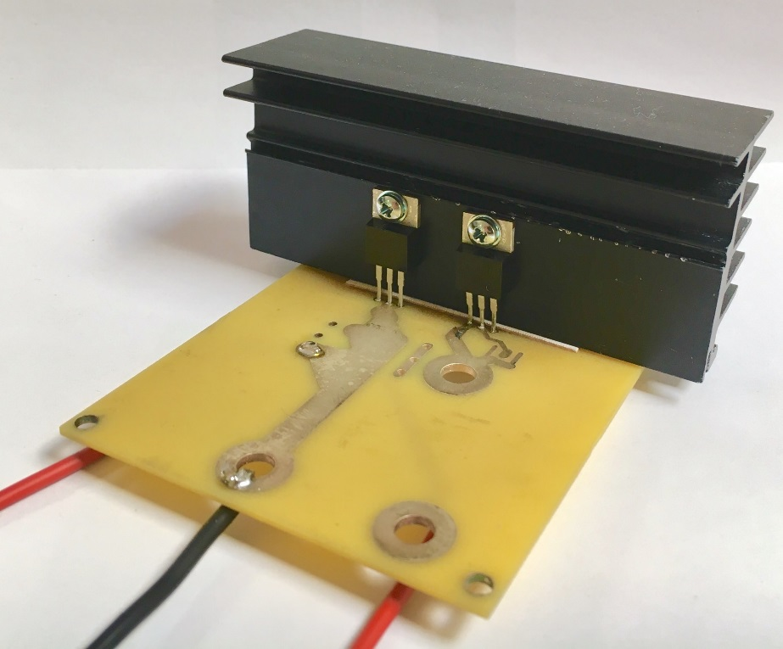

Slide 36
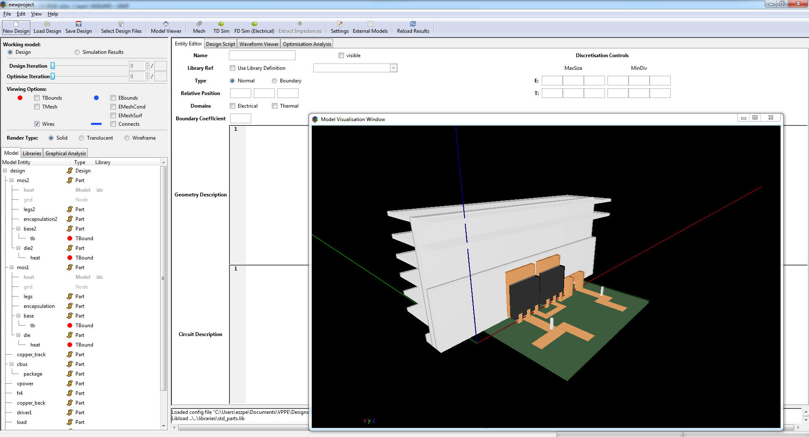
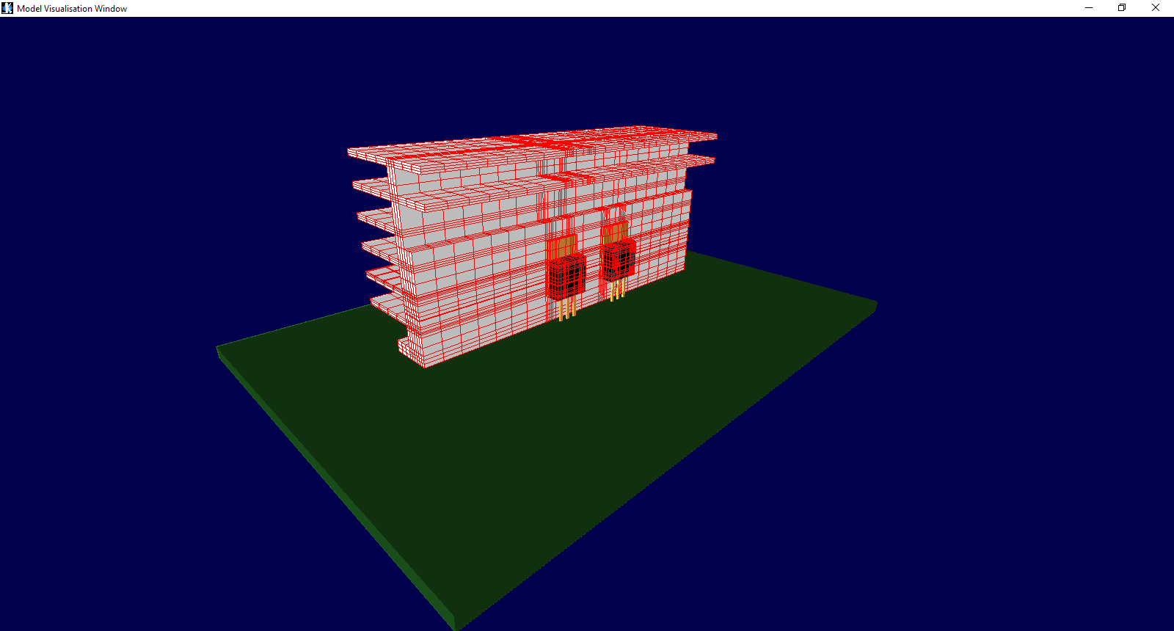
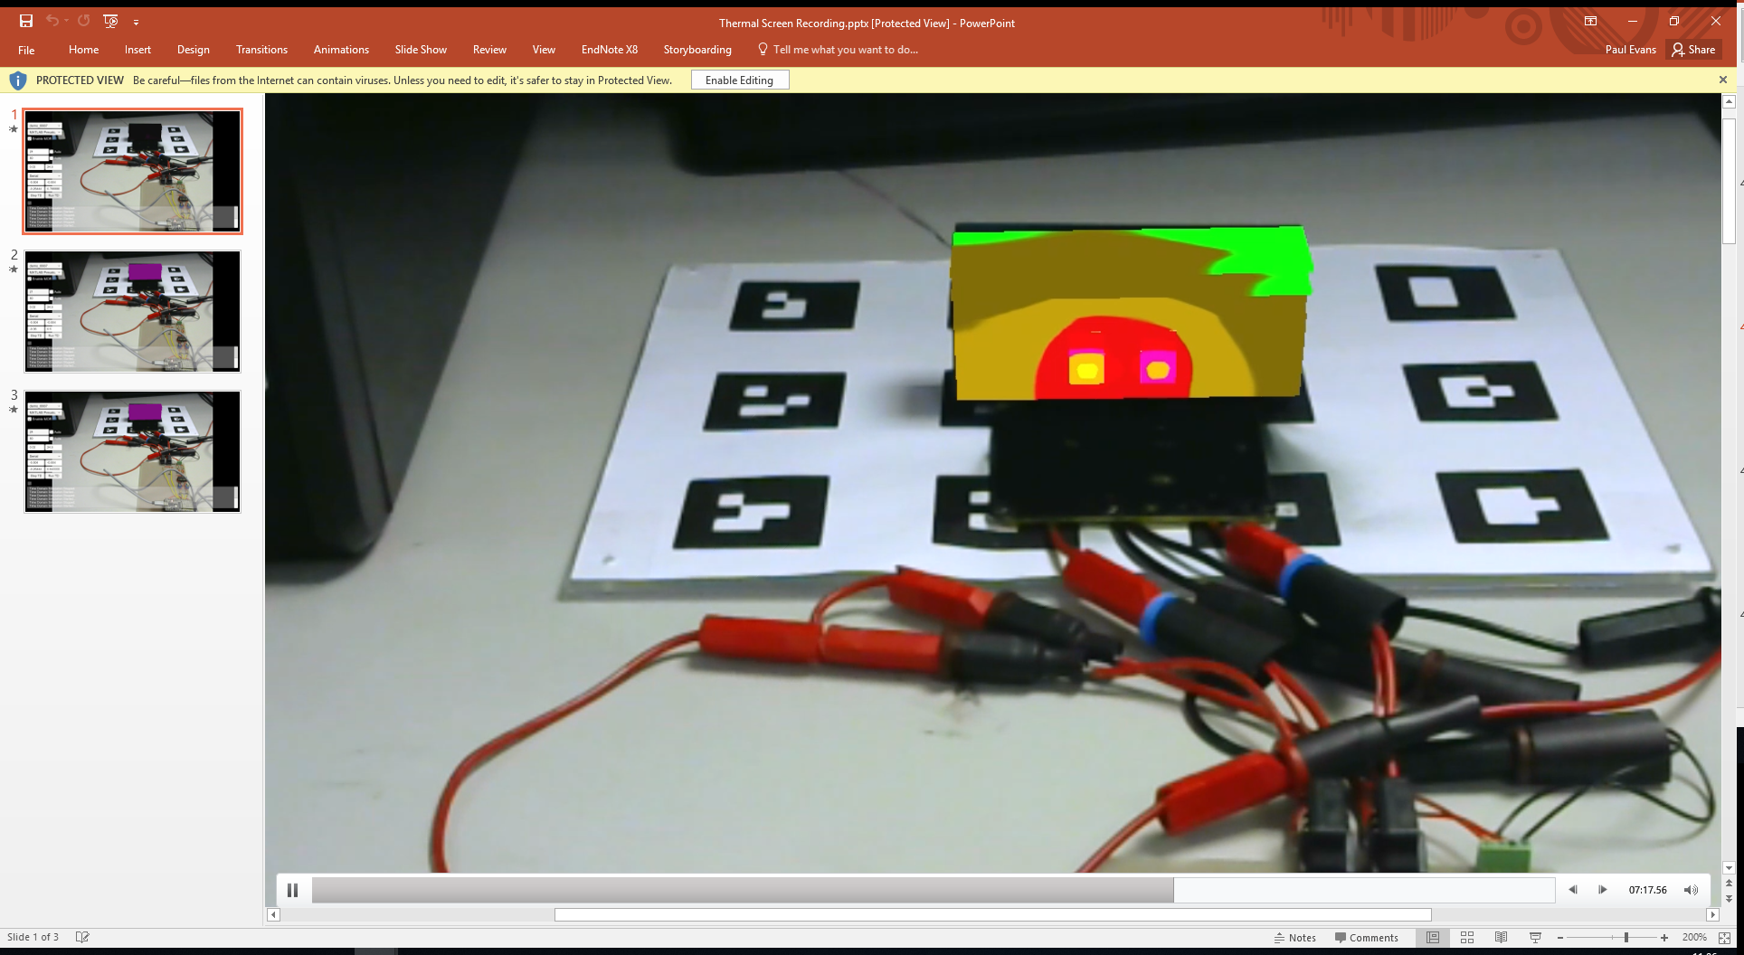
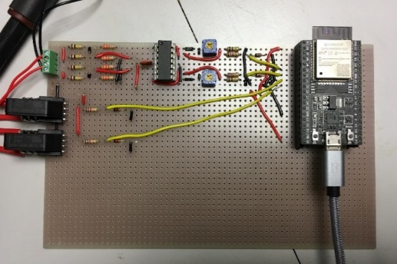

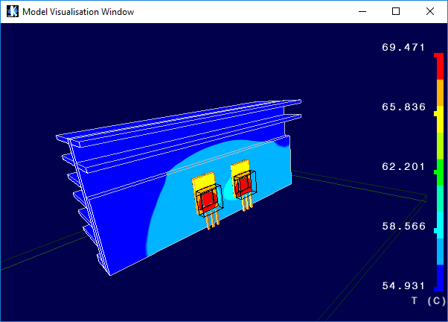



Power Electronics VP Tool
$$\left[M\right]\dot{x}=\left[K\right]x+\left[B\right]u$$
Mesh 3D model & generate system of ODEs
Export model / mesh data & model matrices
Design input
Video feed
AR Code
Library
Voltage / current measurement
Real-Time Simulation & AR
Real-Time Simulation
World Transform Matrix
Projection Matrix
$$\left[\begin{matrix}x_{1} & x_{2} & …\end{matrix}\right]$$
Voltage and current measurement using Wifi enabled microcontroller
Implemented in Unity

Slide 37
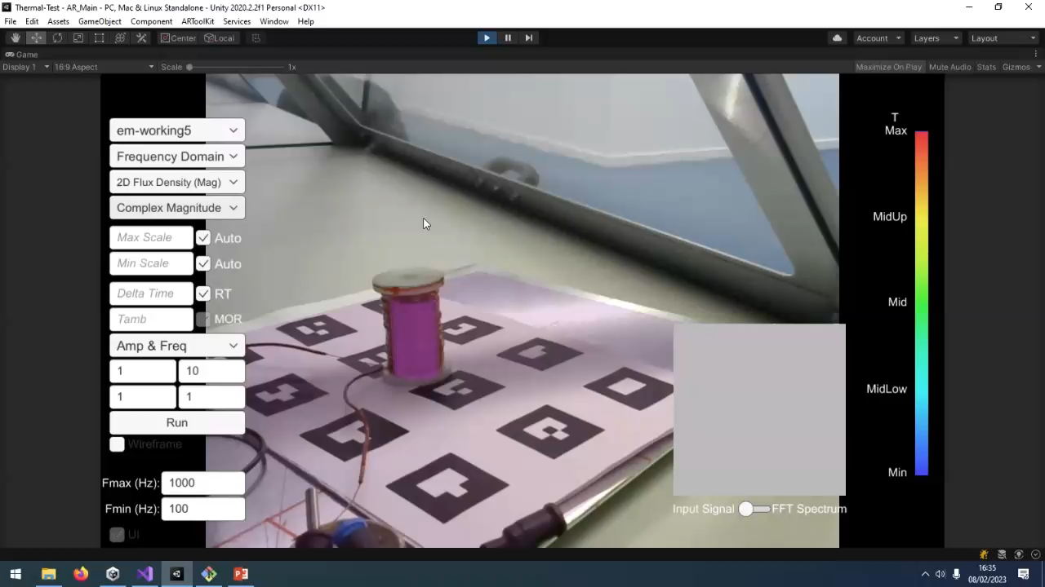

Slide 38


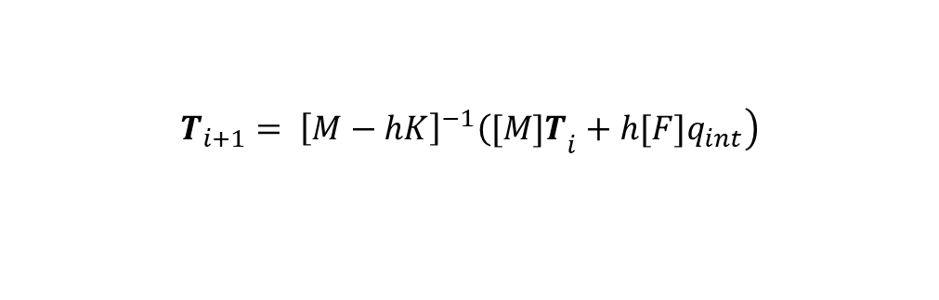
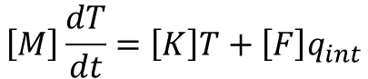
Computing the fields
Coordinate Systems
(2055 – Neo)
$$ρC\frac{∂T}{∂t}−∇∙\left(k∇T\right)−q_{int}=0$$
Heat and temperature linked via heat equation (conduction effects only) – Partial Differential Equation (PDE)
Multivariate calculus
(2055 – Neo)
$$ρC\frac{∂T}{∂t}=k_{x}\frac{∂^{2}T}{∂x^{2}}+k_{y}\frac{∂^{2}T}{∂y^{2}}+k_{z}\frac{∂^{2}T}{∂z^{2}}q_{int}$$
Looks like this in a cartesian coordinate system
Matrix Solvers
(3090 – Phil)
Single PDE can be converted to a very large (>> 10³) set of simultaneous Ordinary Differential Equations (ODEs) in matrix form.
$$\left[M\right]\frac{dT}{dt}=\left[K\right]T+\left[F\right]q_{int}$$
For electromagnetic effects – need to do in frequency domain
$$\left.T_{i+1}= {\left[M−hK\right]}^{−1}{\left([M]T\right.}_{i}+h[F]q_{int}\right)$$
Need to solve equations in matrix form to get Temperature at each time step (frame)
Fast Fourier Transforms
(2055 – Paul)
Numerical Integration
(2055 – Neo)

Slide 39
Virtual Reality

Slide 40
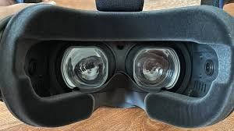
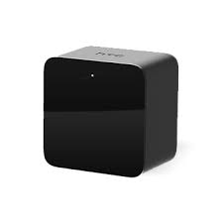
What is it?
Virtual Reality:
Stereoscopic headset provides realistic 3D rendering
Movement of headset causes corresponding change to rendering, given impression that immersed in virtual world
Technical requirement:
World transform matrix must be able to track headset movement in real world
References in real world used to compute headset position/rotation and therefore appropriate transform
Require 2 camera points in virtual world – one for each eye
The rendering process described earlier must be done twice!
Different methods for tracking but HTC use “lighthouse” beacons that the headset uses as reference points

Slide 41
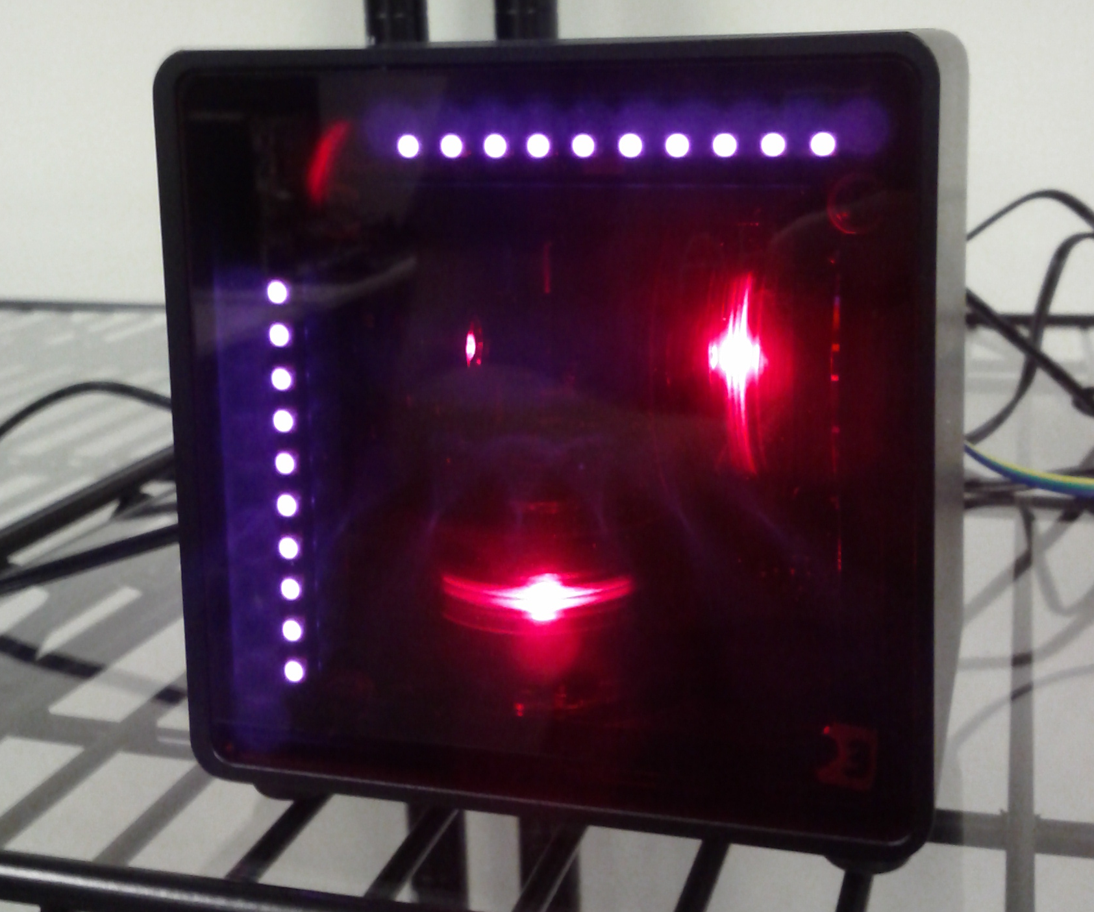
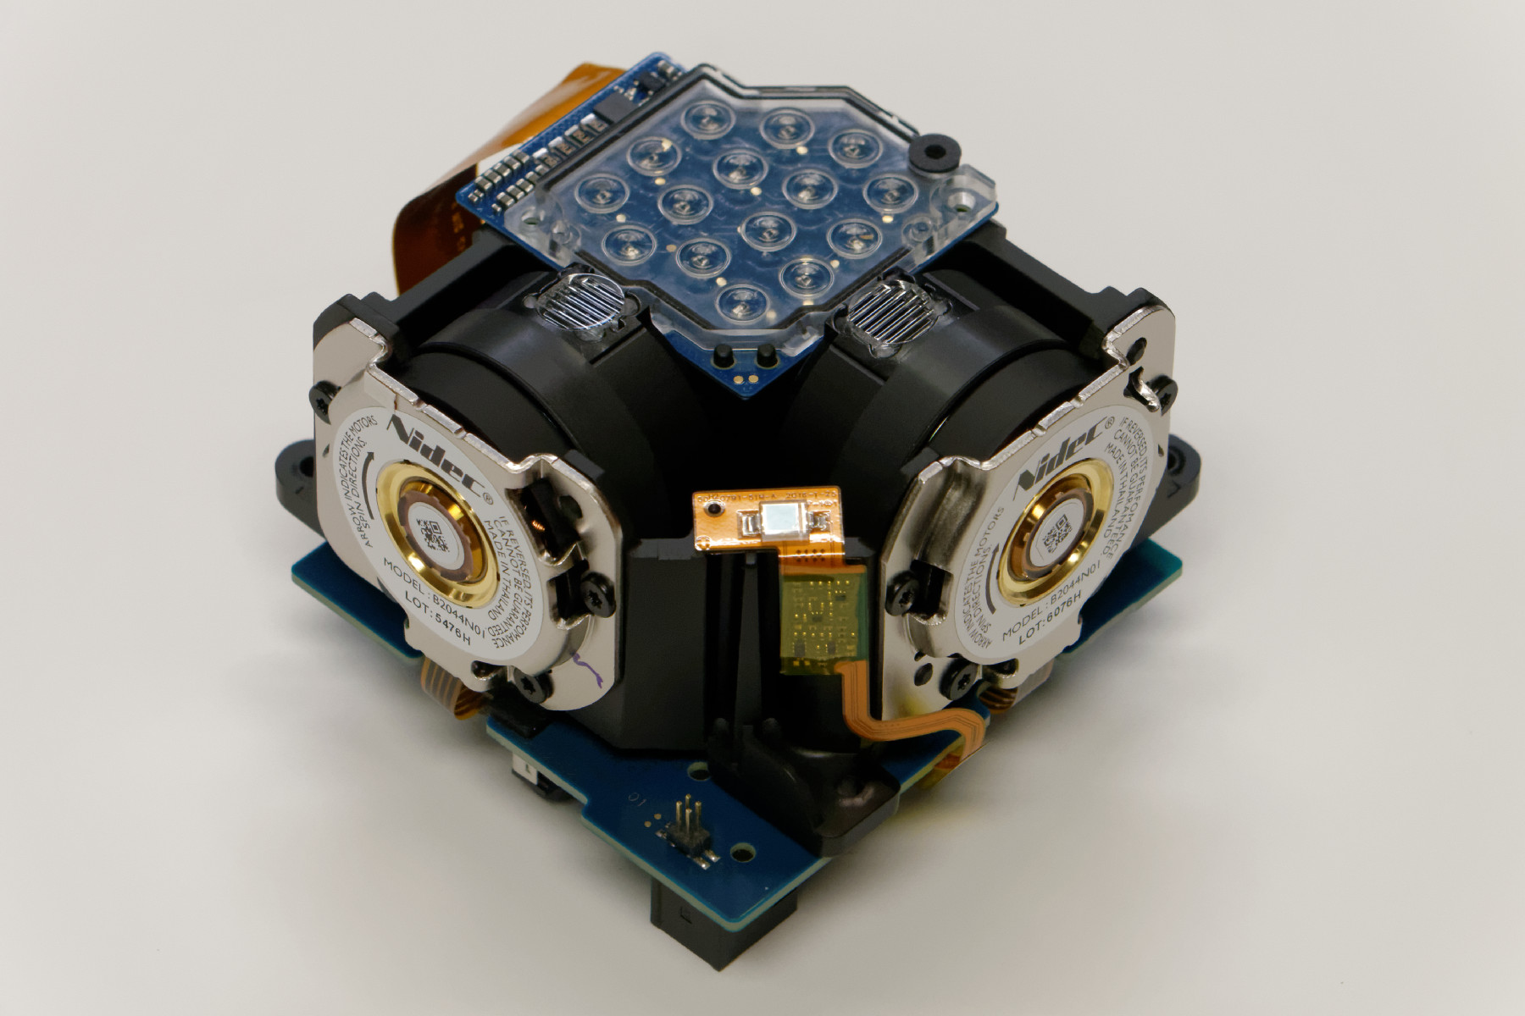
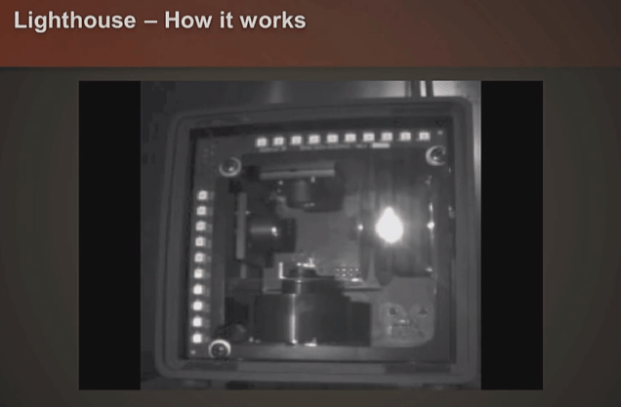
HTC Lighthouse Technology
Sweep two lasers (x,y directions) at set intervals
Timing reset flash from LEDs
Time between reset flash and each of lasers being detected = position in room
Data encoded to signify which lighthouse is broadcasting (up to 16 channels)

Slide 42


HTC Lighthouse Technology
Sensors in headset triangulate position based on laser beam timing (translation matrix)
Lots of sensors, which sensors detect lasers determines rotation matrix
Controller position determined in similar way
https://www.roadtovr.com/htc-vive-lighthouse-fcc-approval-base-station-tracker/

Slide 43


Calibration
Lighthouses can be positioned anywhere, system needs to know how to relate room to lighthouse position
Where is floor, which was is up, etc.
Initial calibration process
Standing
VR doesn’t allow you to walk around (walking around has no effect on virtual position)
Room-scale
Walking around in reality = walking around in VR
For initial testing – use standing, don’t walk around!
For room-scale:
Only use this later, if/when needed
You need to clear a safe area, this is defined in VR.
Must have someone else watching to warn of hazards – will be easy to walk into something/someone or trip over something
System will guide you through calibration process – likely to need to do it at various points (if something changes, system will tell you to recalibrate)

